Slide 1
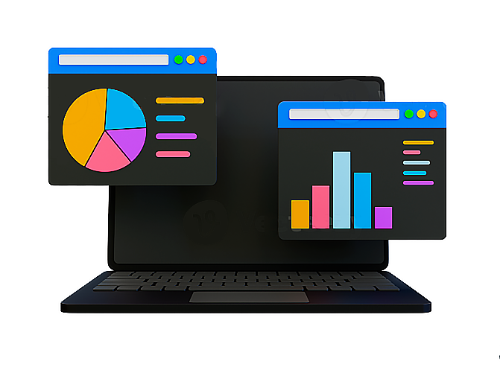
Doctor data data entry automation tool
TO - Dr. Pushpalata Pujari
Assistant Professor of CSIT , GGU
MCA 3RD Semester
BY- novel kathor
Roll No - 22072146

Slide 2
introduction
BRIEF OVERVIEW OF THE PROJECT AND ITS PURPOSE
A PyQt5 application called "DrData" that performs various image processing and text extraction tasks. the application to provide a comprehensive solution for processing and storing data in Excel Sheet.
the need for efficient data extraction and management in various fields
In the past, manual data entry required extensive hours from operators typing information into Excel, leading to inefficiencies and errors. DrData addresses this challenge by automating data extraction from images, streamlining workflows, and enhancing accuracy, empowering organizations across industries. Its advanced features save time, reduce costs, and ensure reliable data management, fostering informed decision-making and driving business success.
Mention the technologies used
Python, PyQt5, OpenCV, Tesseract OCR, numpy , pandas.

Slide 3
Key Features
Bullet points listing the main features of the DrData application, such as : Image processing capabilities (brightness adjustment, noise reduction, contrast adjustment, threshold)
Text extraction from images using Tesseract OCR
Organizing extracted data into Excel for further analysis
User-friendly GUI with intuitive controls
Ability to add labels to images for categorization

Slide 4
Demonstration
HOW TO USE THE APPLICATION
Opening a folder containing images
Adjusting image using slides (brightness, noise reduction, contrast)
Extracting text from images
Viewing and exporting the extracted data

Slide 5
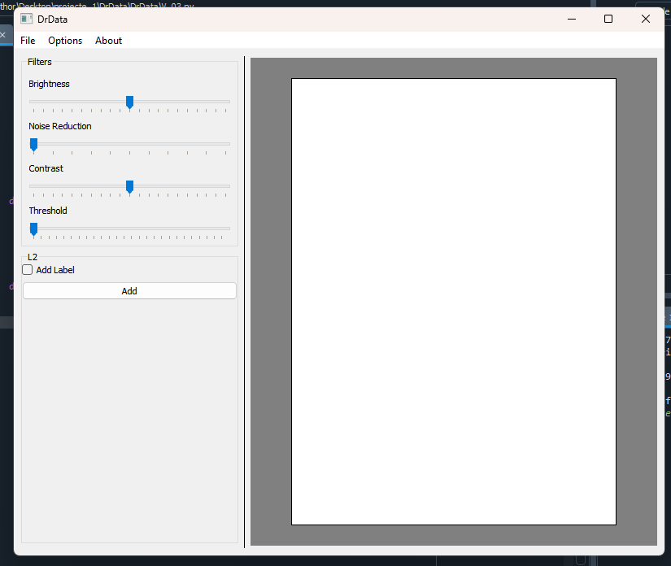
Technical Details
Use of PyQt5 for GUI development :-

Slide 6

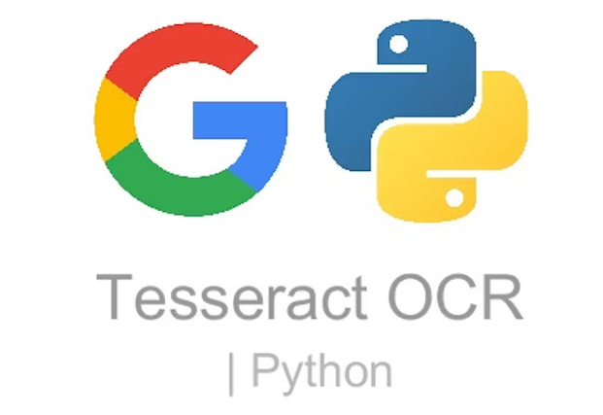
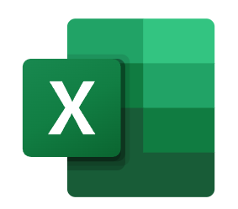
Integration of OpenCV for image processing tasks
Implementation of Tesseract OCR for text extraction
Data processing and Excel export using pandas library

Slide 7
GUI Setup: The code sets up a GUI window using PyQt5, with various widgets like sliders, labels, checkboxes, and buttons for controlling image processing parameters and displaying images.
Image Processing: It includes functions to adjust brightness, reduce noise, adjust contrast, and apply thresholding to images. These functions use OpenCV for image processing operations.
Text Extraction: The application can extract text from images using the Tesseract OCR library (pytesseract). It allows the user to select a folder containing images and extracts text from each image, saving the results to a temporary text file.
Data Processing and Export: After extracting text from all images in the selected folder, the application processes the data and saves it to an Excel file (output.xlsx), organizing it into columns based on the extracted text content.
\

Slide 8

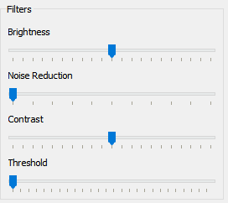
Selecte folder
(Selecte folder 📂)
Data Processing
(Python Scripts)
Temp.txt
(after extracting data it save the data in temp.txt for preprocessing like capital to small , or remove unnecessary data)
Image Processing
(OpenCV Algorithms)
(Using control slider
Preprocess image )
Excel File (Output Data)
Text Extraction
(Tesseract OCR)
(Using tesseract OCR
Text will extract )
After preprocessing the data we get the data in a excel file

Slide 9
Highlight the benefits of using the DrData application:
Bullet points listing the main features of the DrData application, such as : Image processing capabilities (brightness adjustment, noise reduction, contrast adjustment, threshold)
Text extraction from images using Tesseract OCR
Organizing extracted data into Excel for further analysis
User-friendly GUI with intuitive controls
Ability to add labels to images for categorization
By leveraging technologies such as PyQt5, OpenCV, and Tesseract OCR, DrData empowers users to extract data from images with ease, automate repetitive tasks, and organize extracted information into structured formats like Excel spreadsheets. This not only saves time and resources but also enhances the quality and reliability of the data, enabling organizations to make informed decisions and drive business growth.

Slide 10
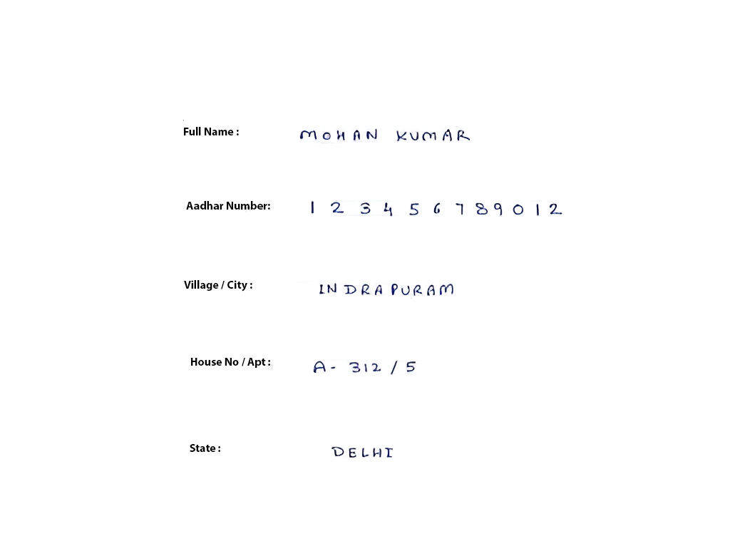
future of this application
integrating text detection and segmentation capabilities into the future of the "DrData" application offers numerous benefits, including improved accuracy, efficiency, and user experience. By embracing these advancements, "DrData" can continue to evolve as a powerful tool for extracting valuable insights from image-based data sources in various fields.
Name
AD no
City
Label
Data
House
State

Slide 11
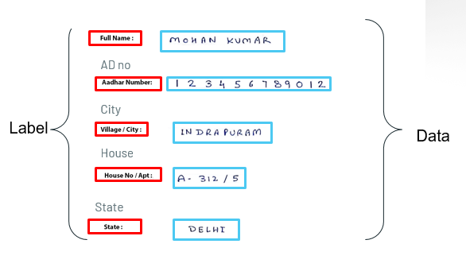
future of this application
integrating text detection and segmentation capabilities into the future of the "DrData" application offers numerous benefits, including improved accuracy, efficiency, and user experience. By embracing these advancements, "DrData" can continue to evolve as a powerful tool for extracting valuable insights from image-based data sources in various fields.
Name’s and city
Name
Preprocessor
AI to correct incorrect
Name’s and city
NLP to extracte data from txt file
Text Extraction
(Tesseract OCR)
Remove extra data

Slide 12
Thanks!

